Slide 1
Timed Writing

Slide 2
Why?
When will I ever need to write a well-crafted essay in 45 minutes or less?
Answers:
SATs, Final Exams, PSATs, college applications, job applications, college exams, general intelligence

Slide 3
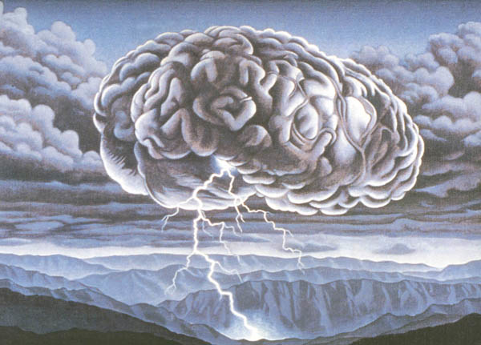
Steps 1 and 2
1. Read and Understand the Prompt (2 minutes)
Strategies = underline, circle, highlight key verbs/words in the prompt (compare, contrast, define, illustrate, etc.)
Most common & worst mistake is misreading the prompt because student is rushing
2. Planning (5 minutes)
Brainstorm ideas: list, web
Create a thesis statement
Create a rough outline

Slide 4
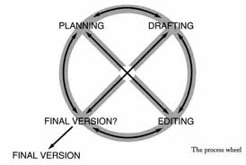
Step 3: Writing (35 minutes)
The Introduction:
Very beginning = creativity draws reader in
If you don’t think of one immediately, skip & go back
Most important part = THESIS
Contains: overall argument, body para. main ideas
The Body:
Each body paragraph needs: topic sentence, specific textual examples (2), explanation/analysis of examples
The Conclusion:
Re-state thesis
End with overall insight

Slide 5
Step 4 and Beyond
Revising and Proofreading (time = any extra)
Look for: spelling/capitalization errors, awkward wording, add transitions
You may not even get to this step.

Slide 6
Prepare!
Look at the 5 sample prompts. For each one, find 2-4 quotes to back up your argument.
This is due tomorrow and worth 10% of your paper grade.
Enjoy

Slide 7
Now what?
Sample Essay:
Read the poems, and then read the sample essay independently
With a partner, find 10 good things about the essay, along with two things that could be improved.

