Slide 1
What is an Anachronism?

Slide 2
Defintion
Something that is “out of place” for it’s time period.
They are either accidents, or attempts at humor.
What modern expressions would be anachronistic if said in the year 2000?

Slide 3
Pepsi Logo

Slide 4
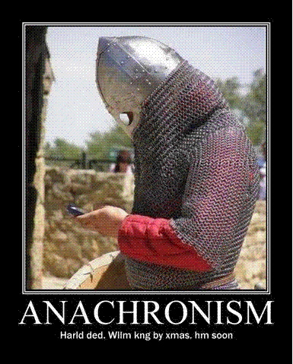
Example 1
What is out of place?
How do you know?
Purpose?

Slide 5
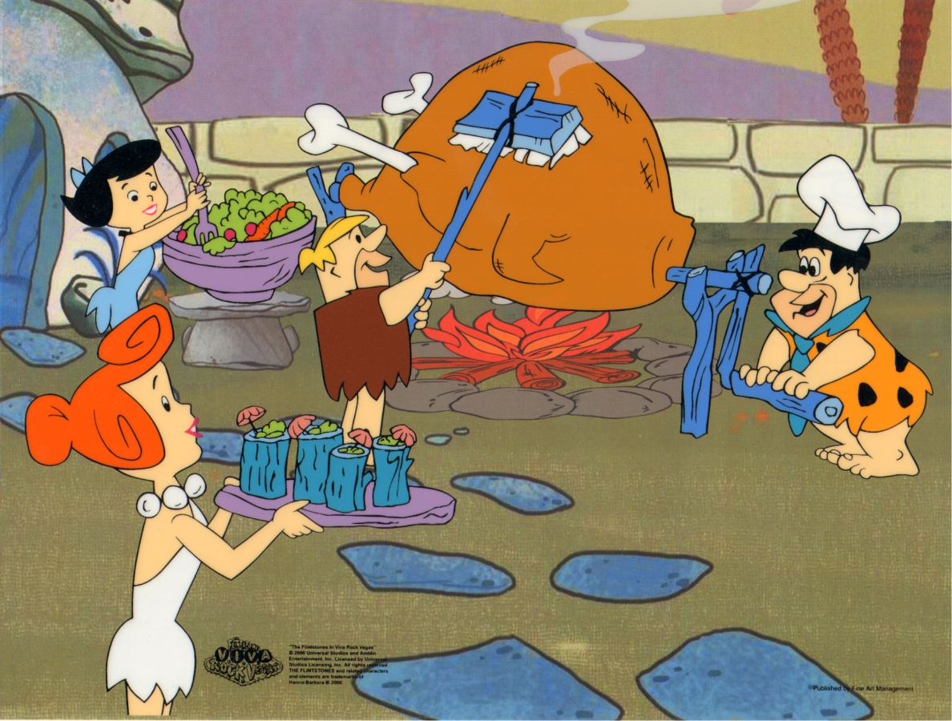
What is out of place?

Slide 6
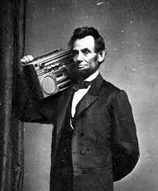
Example 3

Slide 7
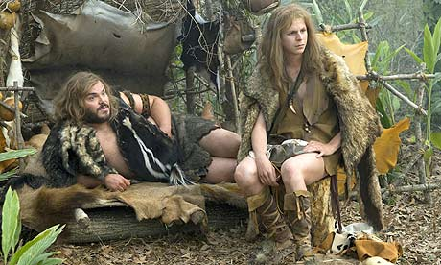
Example 4

Slide 8
Example 4

Slide 9
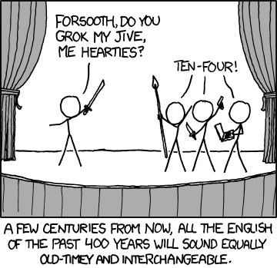
Interesting…

Slide 10
The Game:
With a group of 4-6, write a brief paragraph that contains an anachronism. (5-7 sentences).
The paragraph can be about anything, but make the anachronism as subtle as possible.
Other groups will try to spot the anachronism. If they succeed, you lose. If they fail, your group gets a bonus point (4th nine weeks).

